Slide 1
Interactive Pharmacometric Applications using R and the Shiny Package
Jessica Wojciechowski
18th December 2014
Notes:
The aims of this webinar are to demonstrate to you some examples of representing models in interactive applications and provide some basic code and structure for how this can be achieved.

Slide 2
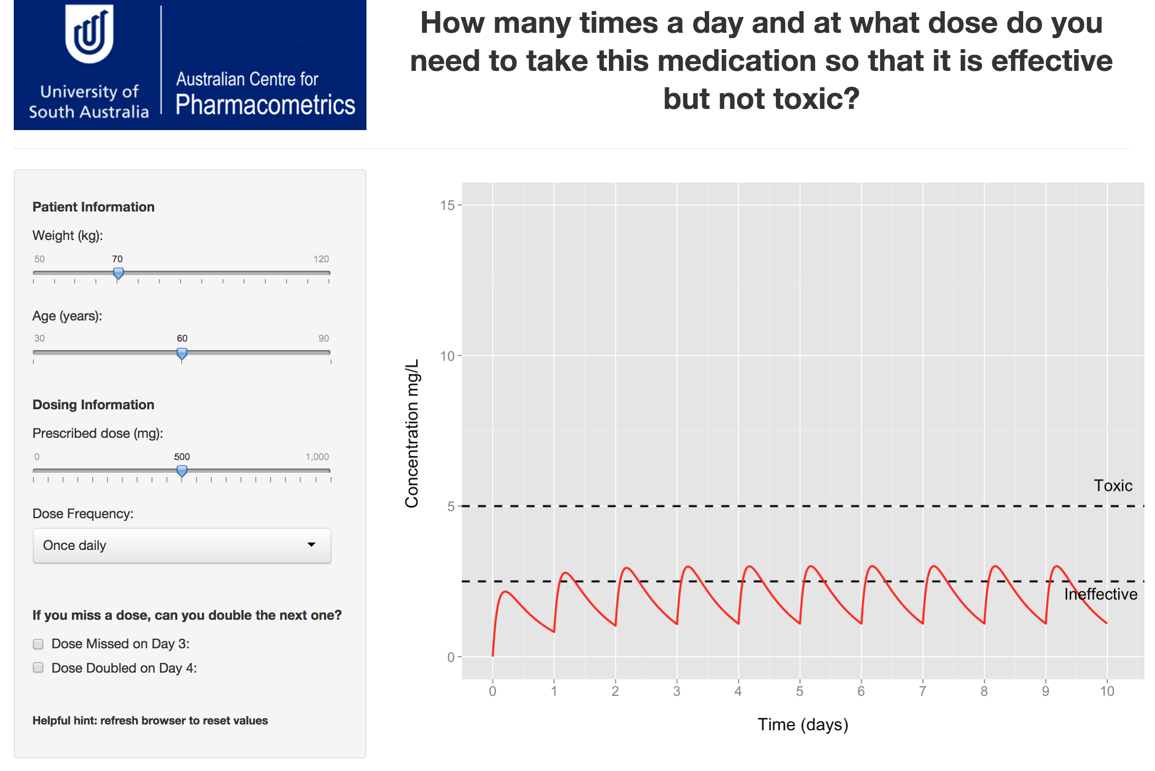
Available online at https://acp-unisa.shinyapps.io/OpenDay/
Notes:
I thought I would start with an example application.
This is an application we developed for Open Day at our university for high school students and their parents. On this day, they visit us and gain some insight about some of the degrees that we offer.
To show-off our pharmacy and pharmaceutical science degrees, we thought we would develop an application demonstrating why different subsets of patients need different doses to prevent toxicity.
We also thought that they might value if we showed them potentially what could happen with some drugs if they missed one dose and doubled the next.
When a Shiny application is updating, the output is “greyed out” indicating to the user that processing is taking place.

Slide 3
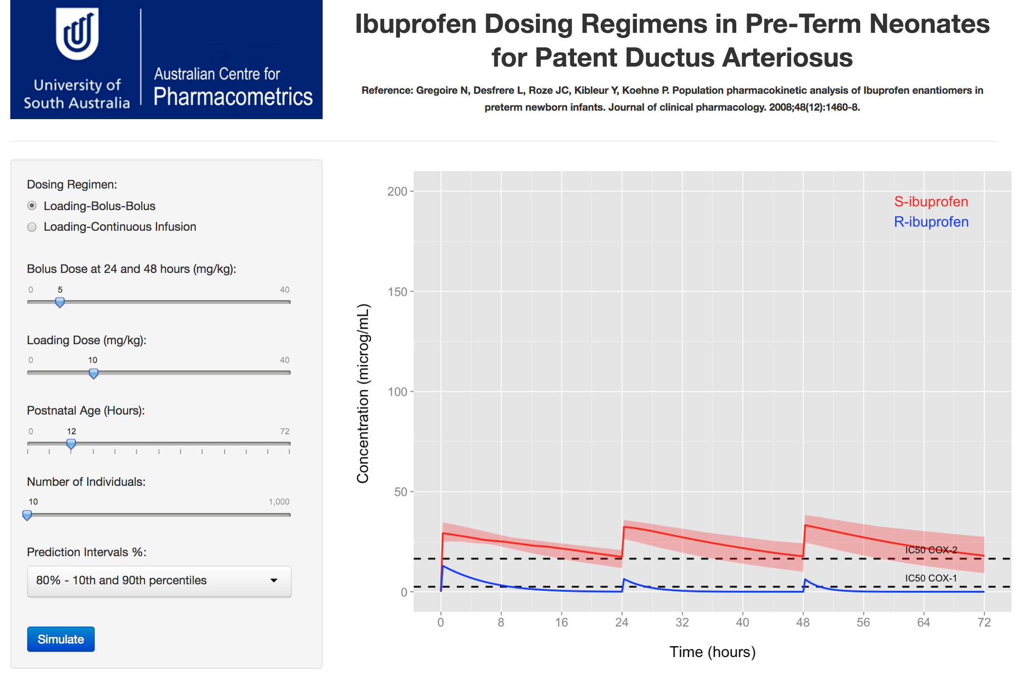
Available online at https://acp-unisa.shinyapps.io/Ibuprofen/
Notes:
Another example application here implements a population pharmacokinetic model of R- and S-ibuprofen in neonates following 3 IV bolus doses of racemic ibuprofen, published by Gregoire et al in Journal of Clinical Pharmacology in 2008.
Using the model, we wanted to conduct some simulations with a loading dose and then a continuous infusion and identify what doses were required to achieve approximately 90% of concentration-time profiles for S-ibuprofen above the IC-50 for the COX-2 enzyme.
We found that using NONMEM and processing its output was slow, and each new scenario we wanted to test was time-consuming and finite.
So we developed an application, and were able to rapidly test scenarios until the result we wanted was achieved.

Slide 4
Shiny for R
Interactively show output for R programs
Flexible R language allows pharmacometric models to be coded
Control in coding:
Fixed and non-fixed elements of pharmacometric model
Appearance of application’s user-interface
Generated output
Share and view applications without an R installation or files containing R code
Viewed on user’s own computer
Or another computer in a web-browser via the Internet
Notes:
R is an open source data analysis language. There are a number of online resources for learning R. Shiny allows…
Fixed and non-fixed elements of the pharmacometric model:
Where fixed elements are population parameter values, population parameter variability, and values for covariate effects.
Non-fixed being covariate categories, dosing information can sometimes be dose amount, dosing frequency, infusion rate, etc.
Appearance of the application’s user-interface:
Even though the examples I just showed generally have the same layout, their design was actually completely controlled by the code describing the user-interface.
Generated output:
Control of appearance of plots using the ggplot2 package
As well the structure of tables and text

Slide 5
Example Application Requirements
Shiny is not supported by Internet Explorer 9 or earlier
R and its package libraries develop and update at a fast pace
Latest versions of packages in the future may not be backwards compatible with the code presented here
Software/R Package Library | Version
R | 3.1.1
RStudio | 0.98.976
Google Chrome | 38.0.2125.122 m
Shiny | 0.10.1
ggplot2 | 1.0.0
Notes:
Just before we get right into these applications, there are a few housekeeping notes for those who aren’t familiar with R or Shiny.
….
These are the software and R package library versions that I have used to create and run these applications.

Slide 6
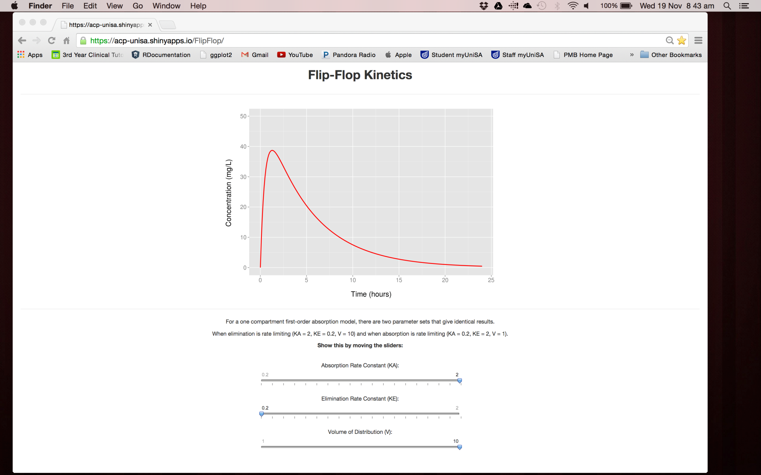
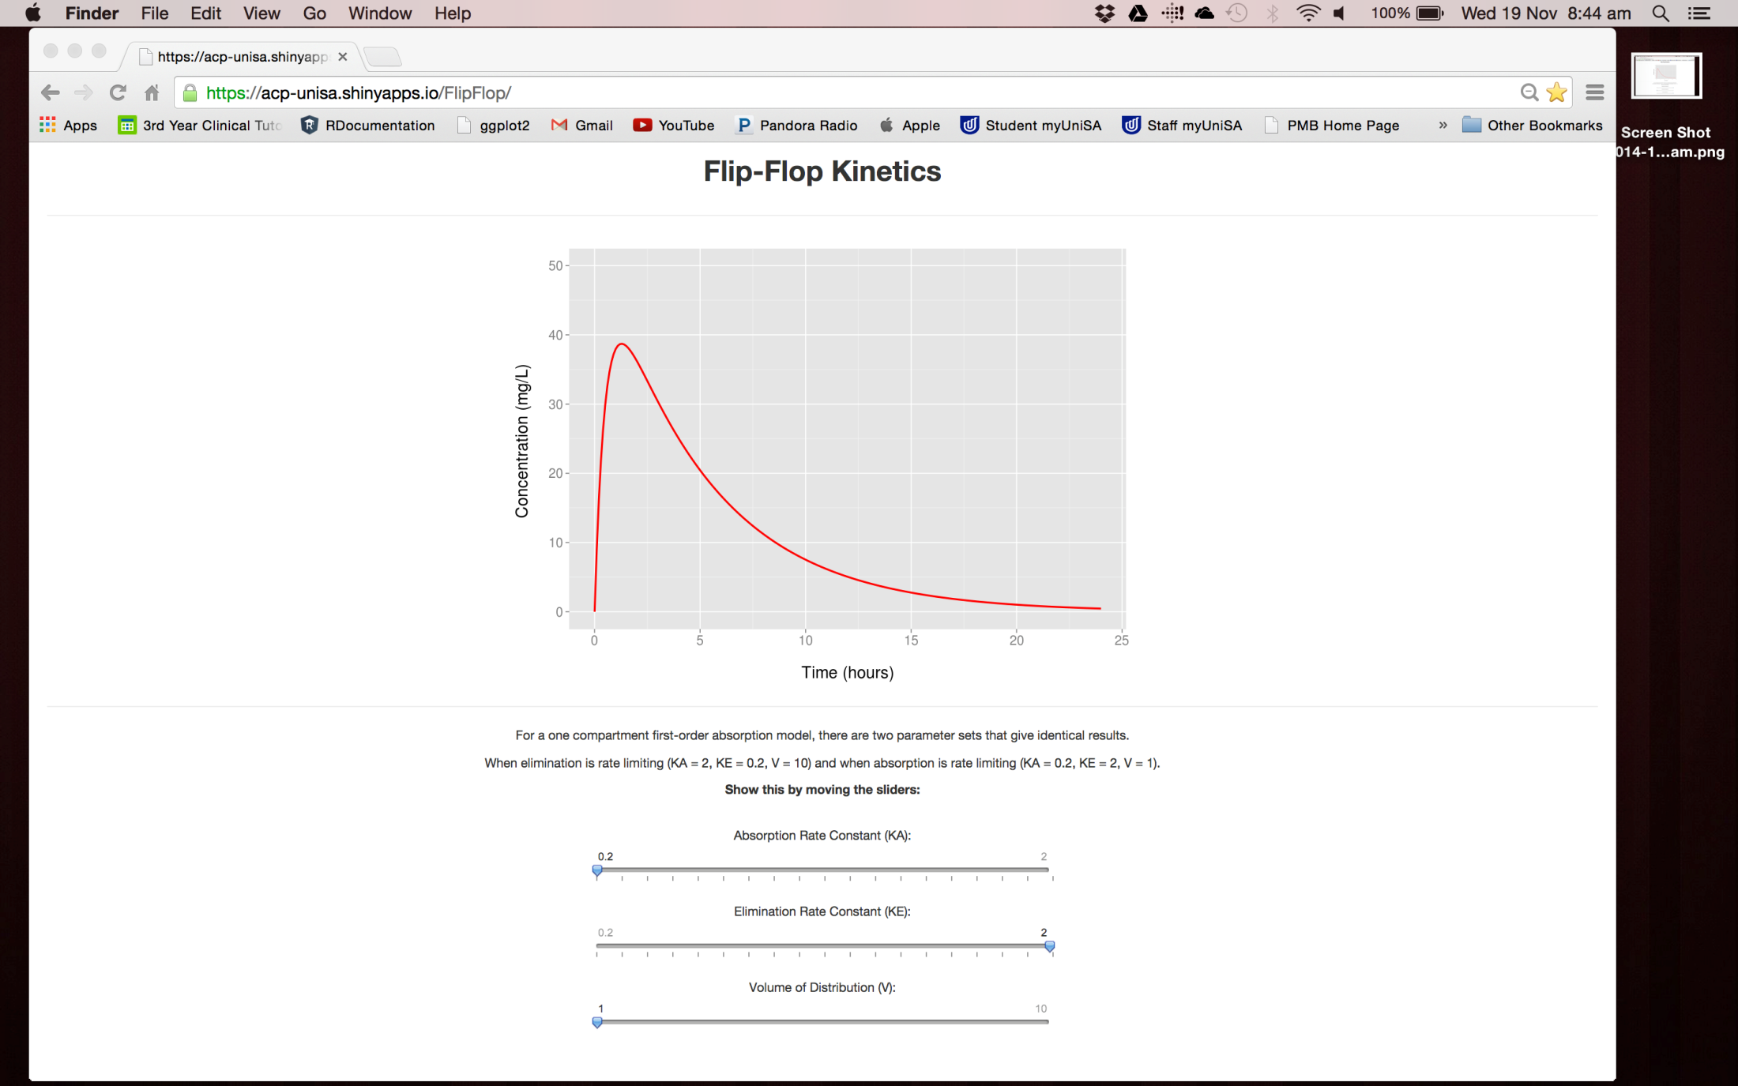
Example Application
Notes:
The example we are going to work through in this webinar is one demonstrating flip-flop pharmacokinetics.
This application implements a model for a hypothetical drug described by 1-compartment first-order absorption kinetics.
It illustrates the concept that for this type of model, there are two parameter sets for KA and KE that give identical results.
On the left - absorption rate is faster than elimination rate
On the right - elimination rate faster than absorption rate.
Show how the application interactively shows this with the sliders.
The slider for volume of distribution also needs to be adjusted when the KA and KE values are swapped to produce the same plot.

Slide 7
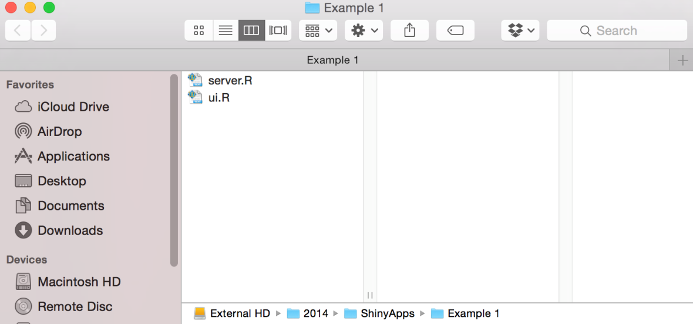
Structure of a Shiny Application
ui.R
Application’s graphical user-interface
server.R
Instructions for turning input into output to be displayed in the user-interface
Need to be saved in the same folder
Notes:
So what is required to make such an application?
Shiny applications are built using two R scripts that communicate with each other.
A user-interface script, named ui.R, which controls layout and the application’s appearance.
And a server script, named server.R, incorporating instructions for user-input, processing data and output by utilising the R language and functions from user-installed packages.
These two scripts need to be named as so and saved in the same folder so that R knows that the two combined form one application.

Slide 8
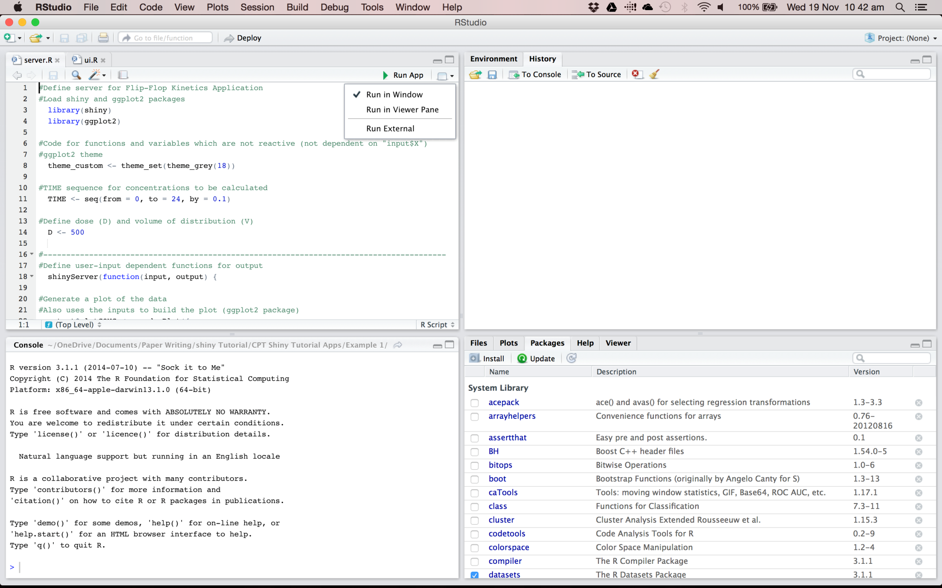
Upload applications to the Internet
RStudio recognises these scripts as a Shiny Application
“Run” button changes to “Run App”
RStudio opens a new window
Application runs in bottom-right pane
Application runs in web-browser
Install R packages
Error messages will appear here when application is running
Notes:
Running a Shiny application on a local computer can be done in two ways, the simplest is from RStudio which is an integrated development environment for R as shown here.
Firstly, you need to install the Shiny package and any other packages the application may use. This application also uses ggplot2.
Installing packages is easy using the “Install” button in the bottom right pane of RStudio.
Then open up the ui.R and server.R scripts for the application into RStudio.
RStudio recognises that these scripts form a Shiny application and the “RunApp” button will appear. Next to the “RunApp” button there is a drop-down menu for options how to view it.
Any errors associated with the code – both general R coding or Shiny code - will appear in the bottom left pane of RStudio.
Finally, applications can be deployed to the Internet straight from RStudio.
Depending on your operating system, other packages and programs may need to be installed prior to deploying an application so I won’t get into that too much today, but there are instructions on the Shiny by RStudio website.

Slide 9
ui.R: Creating a user-interface
Variety of customisable layouts and pre-built widgets
Hierarchical structure
Three levels for creating an interface:
Layout function
fluidPage, fixedPage, etc.
Positioning function
fluidRow, fixedRow, sidebarLayout (sidebarPanel, mainPanel)
Element
Widget functions
Reactive output functions
Headings
Line breaks
Images
Functions of the same level are written as a string within their superior function, separated by “,”
Notes:
Creating a user-interface for your application is easy when you understand the general structure for the code.
For the next couple of slides I’ll describe some of the functions that are used for creating a user-interface and then we’ll work through the code for the Flip-Flop PK application.
…
Layout function:
Creates a layout for the entire page.
All other functions need to be within the brackets of the layout function.
Positioning function:
Places the elements for the UI into specific areas of the page.
Element:
These are the code for widgets, output such as plots that change with widget input, headings, line breaks and images.
They are placed within the brackets of a positioning function, within a layout function.
Multiple elements can be written in the same positioning function or layout function, and they are simply separated by a comma.

Slide 10
ui.R: Shiny Widgets
Interactive elements
Allow users to explore different values or categories of parameters or variables
Store values chosen by the user
That are involved in a cascade of functions in server.R to produce the displayed output
Changing a widget, changes the resulting output object
Examples:
Sliders
Radio buttons
Checkboxes
Selection boxes
Download button
Notes:
The widgets are what makes the application interactive and need to be written into the user-interface code.
They allow the user to explore different values or categories for variables.
They then store that value chosen by the user which is then involved in a cascade of functions in the server.R script leading to an output object which is dependent on the widget’s value.
So changing a widget will then change the resulting output object.
Examples of these widgets, which we’ve already seen in the examples shown earlier are…

Slide 11
ui.R: Displaying Reactive Output
Output functions call R objects in server.R to the UI
Examples:
plotOutput
tableOutput
textOutput
Specific for the object in server.R
i.e. ggplot2 object called by plotOutput
Notes:
The output that changes with widget input also needs to be placed somewhere in the user-interface.
There are a series of functions that call R objects from server.R (our script containing application instructions) into the user-interface.
These functions are specific for that object.
For example, a ggplot2 object written in server.R needs to be called into the user-interface using the plotOutput function.
So let’s look at how this code for a user-interface looks!

Slide 12
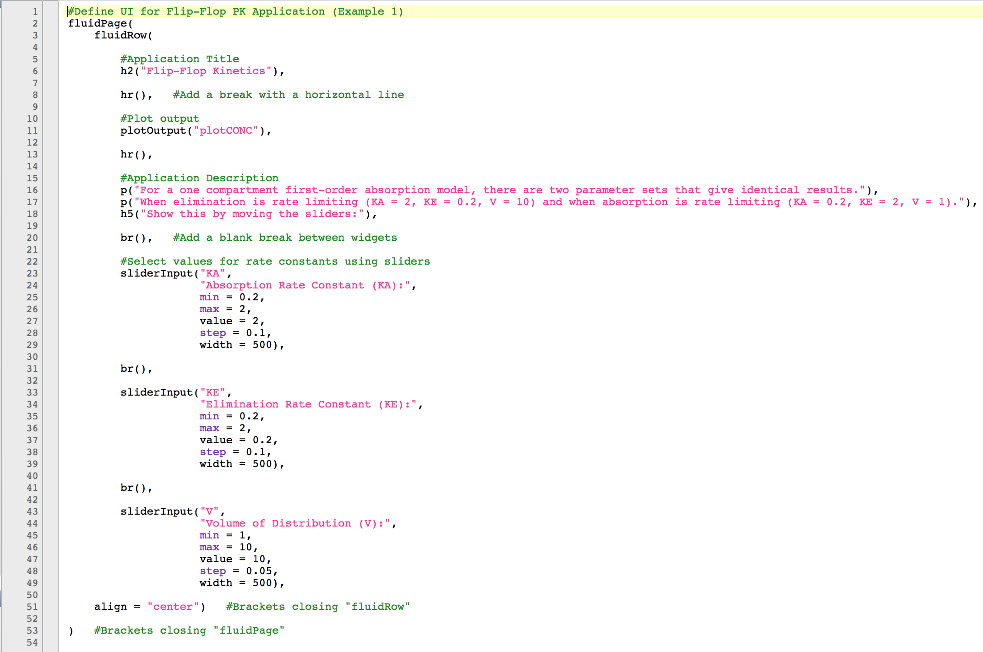
Notes:
Beginning from the top we have:
fluidPage – our layout function. Creates a page that adjusts the size and arrangement of its elements to the dimensions of the browser that the application is running in.
Within fluidPage we have:
fluidRow – our positioning function specific for fluidPage.
This function allows you to align elements into a single row.
If you use the column argument – even though it’s not shown here, you can delegate them horizontal space within that row.
However, in this example, they are actually stacked up on each other vertically in the same “row.”
Everything within fluidRow is now an element.
h2 function creates a heading. A function adopted from HTML.
hr creates a horizontal line between the heading and the next element.
plotOutput positions our output plot which is created in the server.R script and called plotCONC.
p function creates a paragraph of unformatted text for our application instructions.
br creates a line break to create space between elements.
sliderInput is the function for creating a slider. It needs a “NAME” where whatever value for the slider is selected it can be called in server.R, and then a “LABEL” which will be seen in the user-interface.
Then describe the other arguments and closing brackets.

Slide 13
server.R: Application Instructions
Controls the processing of widget input to display output to the UI
Can use your favourite R packages and their functions
For example:
ggplot2; creating plots
plyr; split and rearrange data
deSolve; differential equation solver
Structure of server.R code plays an important role:
Minimising redundant computation
Maximising application speed
Notes:
The server.R script can be a little bit more complicated depending on how complicated your model is or how much output you want the application to show.
However, for those experienced with the R language, writing server.R consists of using the same packages, functions and arguments to process information as previously in R.
The only difference is where some of this code needs to placed within the script.
Shiny re-runs parts of the server.R code every time the value for a widget changes.
Therefore, you don’t want computationally intense code that does not change when a widget changes to be re-run every time because it will slow down your application update time.
You need to think about which parts of your code are reactive and what is non-reactive.

Slide 14
server.R: Non-Reactive vs. Reactive
“Non-reactive” objects include:
Package libraries
Constant expressions, i.e., time
Loaded datasets
Objects dependent on widget input are “reactive”
Reactive objects need to be within the shinyServer function in server.R
They are called from ui.R to server.R by the widget’s name:
KA in ui.R = input$KA in server.R
The value for the reactive object updates every time input from a widget changes
Code in shinyServer re-executes with every widget change
Code outside shinyServer is run once on application initiation
Notes:
“Non-reactive” objects have values that are not dependent on input from widgets.
For example; your loaded package libraries, constant expressions such as one creating a time sequence, or if you choose to pre-load a dataset into the application.
Therefore, objects that are called “reactive,” are dependent on widget input.
These reactive objects need to be coded within the function called shinyServer.
And it is this code in shinyServer that is re-run on every widget change.
Code outside of shinyServer, but still within server.R, is run only once when the application is run for the first time.
The most basic reactive object is the value from the widget itself. In server.R this value is represented using the widget’s name that was described in ui.R.
But it’s also important to remember that any object that is dependent on the widget value is also “reactive” and code defining it needs to be within shinyServer.

Slide 15
server.R: Sending Reactive Output to the UI
Functions that create reactive objects to be sent to ui.R
renderPlot
renderTable
renderText
Can contain code for the reactive object and code processing widget input
Code within shinyServer
Specific for the object type
i.e. ggplot2 object defined within renderPlot
Notes:
Therefore, any output object such as a plot, table or text that is in some way dependent on widget input also needs to be placed within shinyServer.
The code creating that object also needs to be within a render function.
This object is given the name that is then used in the ui.R script for positioning it in the application.
Just like how plotOutput called a plot object from server.R to the user-interface script in ui, renderPlot creates the reactive plot object in server.R to be sent to the user-interface.
So let’s have a look at what the code for server.R looks like.

Slide 16
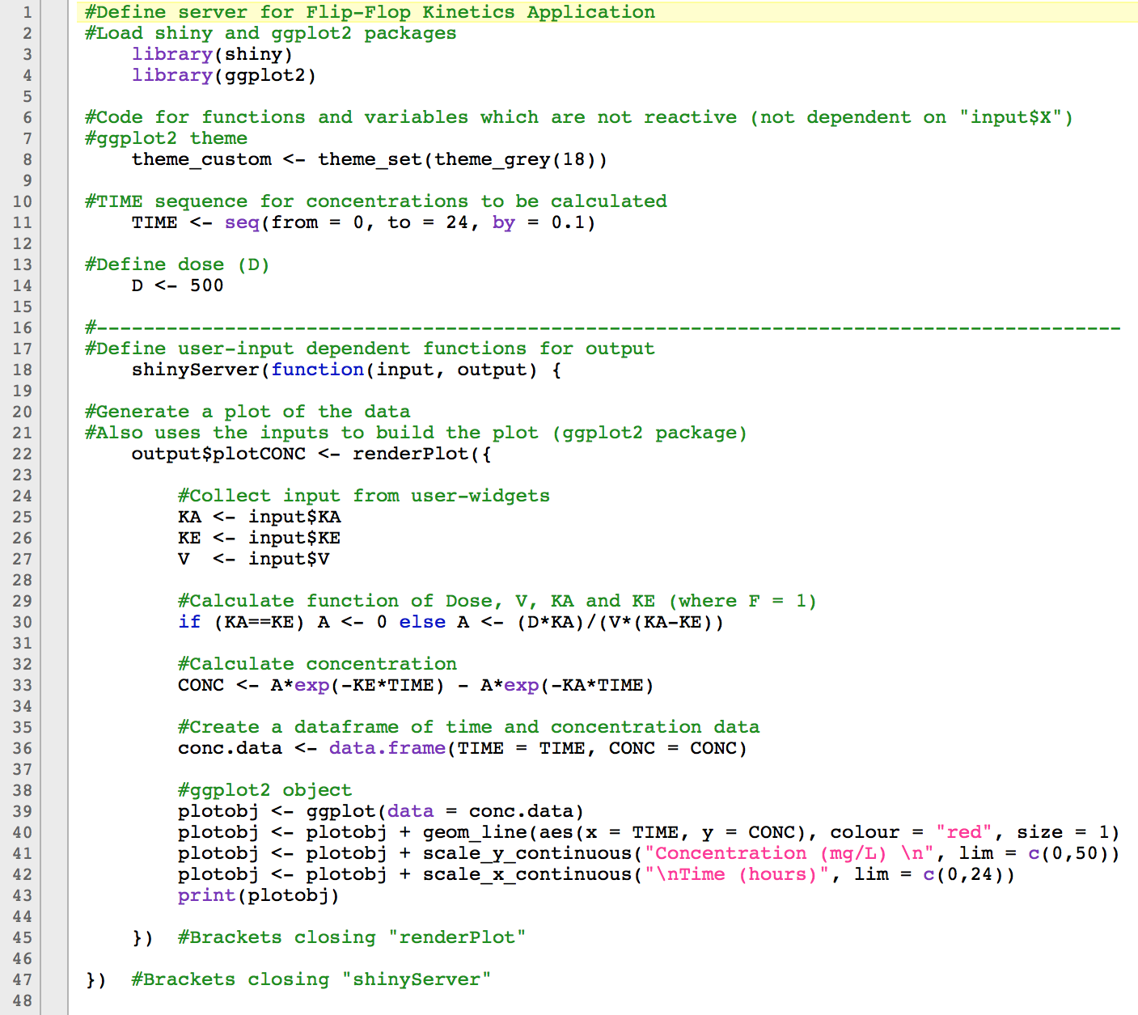
“Non-Reactive”
“Reactive”
Notes:
Starting from the top again:
We have our “non-reactive” section for code that is not dependent on widget-input such as the package libraries, code amending the ggplot2 theme, creating a TIME sequence from 0 to 24 hours at increments of 0.1 of an hour, and a dose.
Then underneath:
Is our “reactive” section beginning with the opening brackets for the shinyServer function.
plotCONC is defined as an “output” object and then code defining plotCONC is within the renderPlot function for creating a reactive plot.
Each of the widget values are then called in as input (and we assume that bioavailability is 100%).
And then their values are used to calculate the concentration-time profile over a 24 hour period.
A ggplot2 object is created using the newly created data frame of time and concentration.
And that’s how this flip-flop pharmacokinetics application is made!

Slide 17
Sharing Shiny Applications
Share by passing on ui.R and server.R script to a colleague with an installation of R/RStudio and the installed Shiny package
Host on a web-server:
ShinyApps.io
Shiny Server
Shiny Server Pro
Flip-Flop PK example freely available online at:
https://acp-unisa.shinyapps.io/FlipFlop/
Notes:
These applications can easily be shared by sending the ui.R and server.R scripts to a colleague with an R installation with the Shiny package.
However, they can also be hosted on web-servers making them accessible to those unfamiliar with, or do not have an installation of R.
ShinyApps.io allows you to upload applications from an R session to a server hosted by RStudio for free but does not guarantee privacy.
The Flip-Flop Pharmacokinetics example, like the first 2 examples, is freely available online using this link and is hosted by RStudio.
Shiny Server and Shiny Server Pro are separate software that can be installed on your own server if you want to host it yourself. However, is only available to servers running specific Linux distributions.
Shiny Server is open source whereas Shiny Server Pro is a commercial version with enhanced security.

Slide 18
Useful Shiny Resources
Shiny by RStudio
Shiny developers provide a tutorial series built with exercises and discussion boards
http://shiny.rstudio.com/
Stack Overflow
http://stackoverflow.com/questions/tagged/shiny
GitHub
https://github.com/rstudio/shiny
Shiny Google mailing list
https://groups.google.com/d/forum/shiny-discuss
Commercially available book, “Web Application Development with R using Shiny” by Chris Beeley
Notes:
Finally, there are some useful Shiny resources for those who are keen to develop their own applications…
Also we currently have a tutorial paper about creating interactive pharmacometric applications using R and the Shiny package under review in CPT: Pharmacometrics and Systems Pharmacology which will go into more detail for the 3 example applications presented here.
It will also have the ui.R and server.R scripts for each application and an example R script for how to code and simulate a pharmacometric model in R for those who don’t quite have experience with coding these models.

